Slide 1
PI Analytics

Slide 2
Analysis as per Total Users Perspective
Starting the Analysis by dissecting the Users data and Funneling as per Design Version.
Finding number of users by design versions category.
Analyzing time spent on assessment page by users

Slide 3
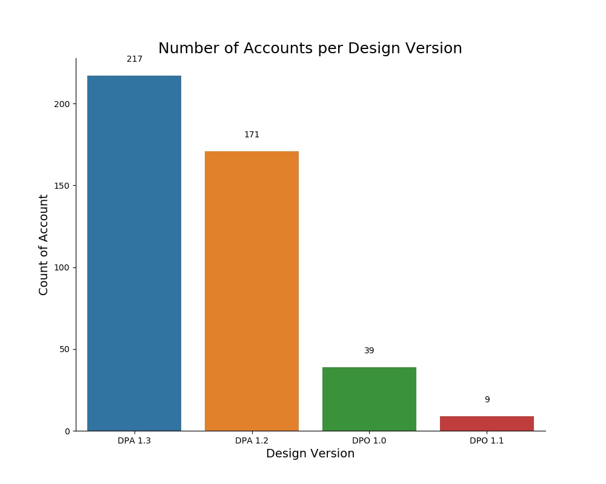
Number of Users by Design Version
Design Version | User_ID
DPA 1.2 | 171
DPA 1.3 | 217
DPO 1.0 | 39
DPO 1.1 | 9
Grand Total | 436

Slide 4
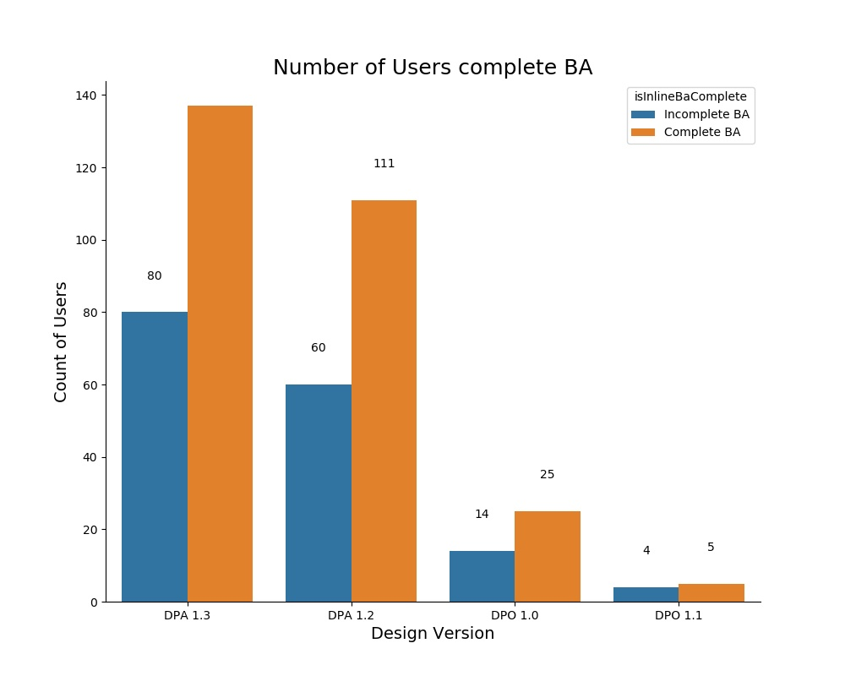
Number of Users by Assessment
Design Version | Incomplete BA | Complete BA | Grand Total
DPA 1.2 | 60 | 111 | 171
DPA 1.3 | 80 | 137 | 217
DPO 1.0 | 14 | 25 | 39
DPO 1.1 | 4 | 5 | 9
Grand Total | 158 | 278 | 436

Slide 5
Total Time Spent on Assessment Pages(Hours)
Design Version | Incomplete BA | Complete BA | Grand Total
DPA 1.2 | 3:08:31 | 12:56:38 | 16:05:09
DPA 1.3 | 0:43:17 | 21:44:34 | 22:27:51
DPO 1.0 | 0:00:00 | 7:47:31 | 7:47:31
DPO 1.1 | 0:17:07 | 0:07:28 | 0:24:35
Grand Total | 4:08:55 | 18:36:11 | 22:45:06

Slide 6
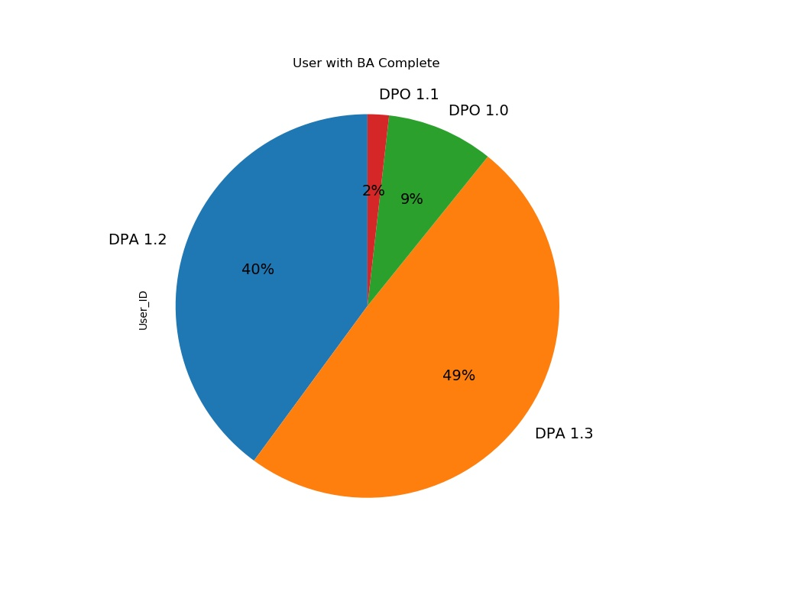
Number of Users with Complete BA
Design Version | User ID
DPA 1.2 | 111
DPA 1.3 | 137
DPO 1.0 | 25
DPO 1.1 | 5

Slide 7
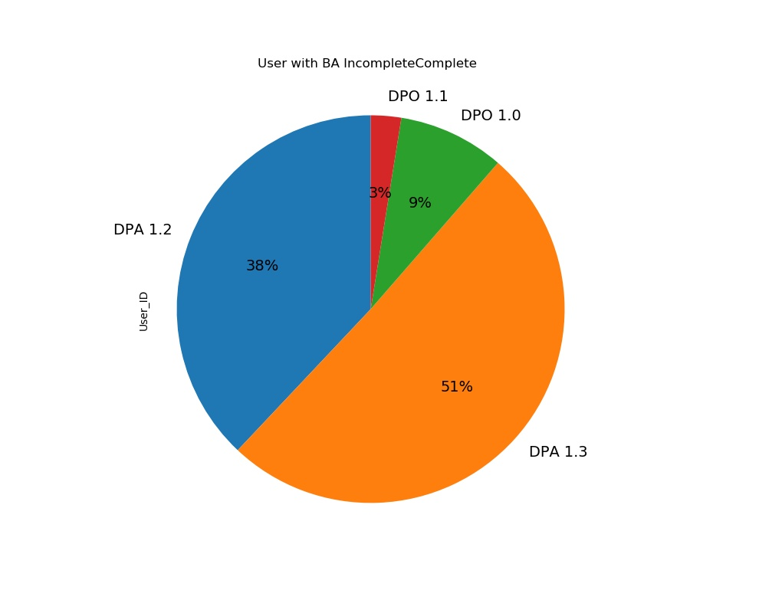
Number of Users with Incomplete BA
Design Version | User ID
DPA 1.2 | 60
DPA 1.3 | 80
DPO 1.0 | 14
DPO 1.1 | 4

Slide 8
Data set Into Complete BA and Incomplete BA

Slide 9
Conversion Rate of users by Complete BA
Design Version | User ID in %
DPA 1.2 | 64.91
DPA 1.3 | 63.13
DPO 1.0 | 64.1
DPO 1.1 | 55.56
Design Version | User ID
DPA 1.2 | 171
DPA 1.3 | 217
DPO 1.0 | 39
DPO 1.1 | 9

Slide 10
Conversation rate of users by Incomplete BA
Design Version | User ID
DPA 1.2 | 171
DPA 1.3 | 217
DPO 1.0 | 39
DPO 1.1 | 9
Design Version | User ID in %
DPA 1.2 | 35.09
DPA 1.3 | 36.87
DPO 1.0 | 35.9
DPO 1.1 | 44.44

Slide 11
Analyzing Complete BA and Incomplete BA by Time

Slide 12
Time Spent by Complete BA Users
Design Version | Assessment Start Page | Self Concept Page | BA Self Page | Completed Page | total Assessment | User_ID
DPA 1.2 | 1:09:53 | 5:53:02 | 5:25:24 | 0:12:53 | 12:56:38 | 111
DPA 1.3 | 1:11:41 | 6:18:12 | 4:16:03 | 9:44:35 | 21:44:34 | 137
DPO 1.0 | 0:21:08 | 0:51:22 | 0:36:02 | 5:58:46 | 7:47:31 | 25
DPO 1.1 | 0:00:16 | 0:03:40 | 0:02:57 | 0:00:15 | 0:07:28 | 5
Grand Total | 2:42:58 | 13:06:16 | 10:20:26 | 15:56:29 | 18:36:11 | 278

Slide 13
Time Spent by Incomplete BA Users
Design Version | Assessment Start Page | Self Concept Page | BA Self Page | Completed Page | total Assessment | User_ID
DPA 1.2 | 0:21:19 | 0:24:20 | 0:23:43 | 0:18:39 | 3:08:31 | 60
DPA 1.3 | 0:04:21 | 0:37:09 | 0:01:44 | 0:00:03 | 0:43:17 | 80
DPO 1.0 | 0:00:00 | 0:00:00 | 0:00:00 | 0:00:00 | 0:00:00 | 14
DPO 1.1 | 0:17:07 | 0:00:00 | 0:00:00 | 0:00:00 | 0:17:07 | 4
Grand Total | 0:42:47 | 1:01:29 | 0:25:27 | 0:18:42 | 4:08:55 | 158

Slide 14
Loading time by Users(hours)
Complete BA Users
Incomplete BA Users
Design Version | Loading Page
DPA 1.2 | 0:15:26
DPA 1.3 | 0:14:03
DPO 1.0 | 0:00:13
DPO 1.1 | 0:00:20
Grand Total | 0:30:02
Design Version | Loading Page
DPA 1.2 | 1:40:22
DPA 1.3 | 0:00:00
DPO 1.0 | 0:00:00
DPO 1.1 | 0:00:00
Grand Total | 1:40:22

Slide 15
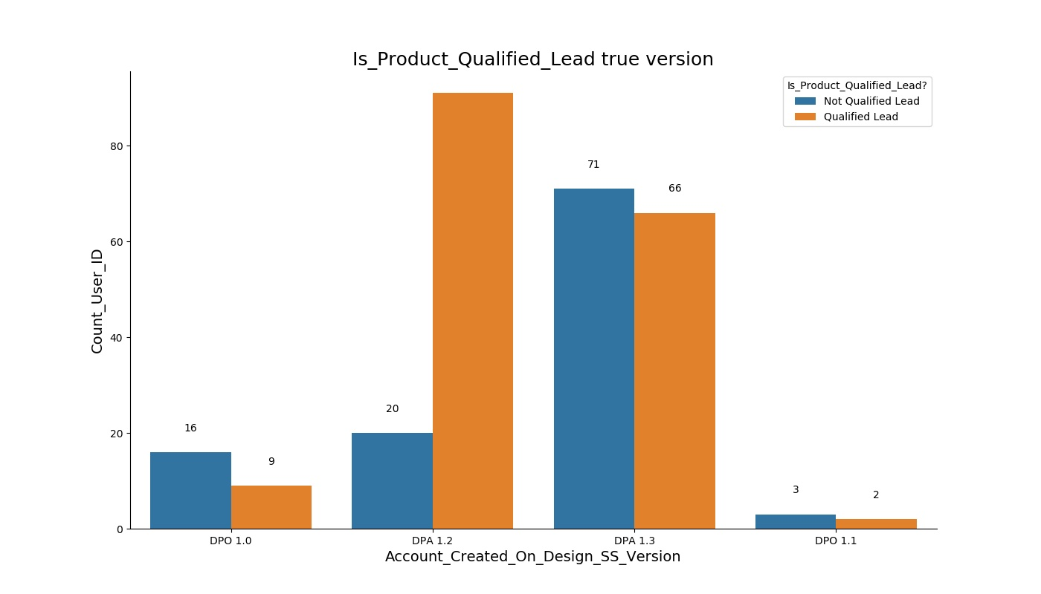
Qualified Lead by Complete BA Users
Design Version | Not Qualified Lead | Qualified Lead | Grand Total
DPA 1.2 | 20 | 91 | 111
DPA 1.3 | 71 | 66 | 137
DPO 1.0 | 16 | 9 | 25
DPO 1.1 | 3 | 2 | 5
Grand Total | 110 | 168 | 278

Slide 16
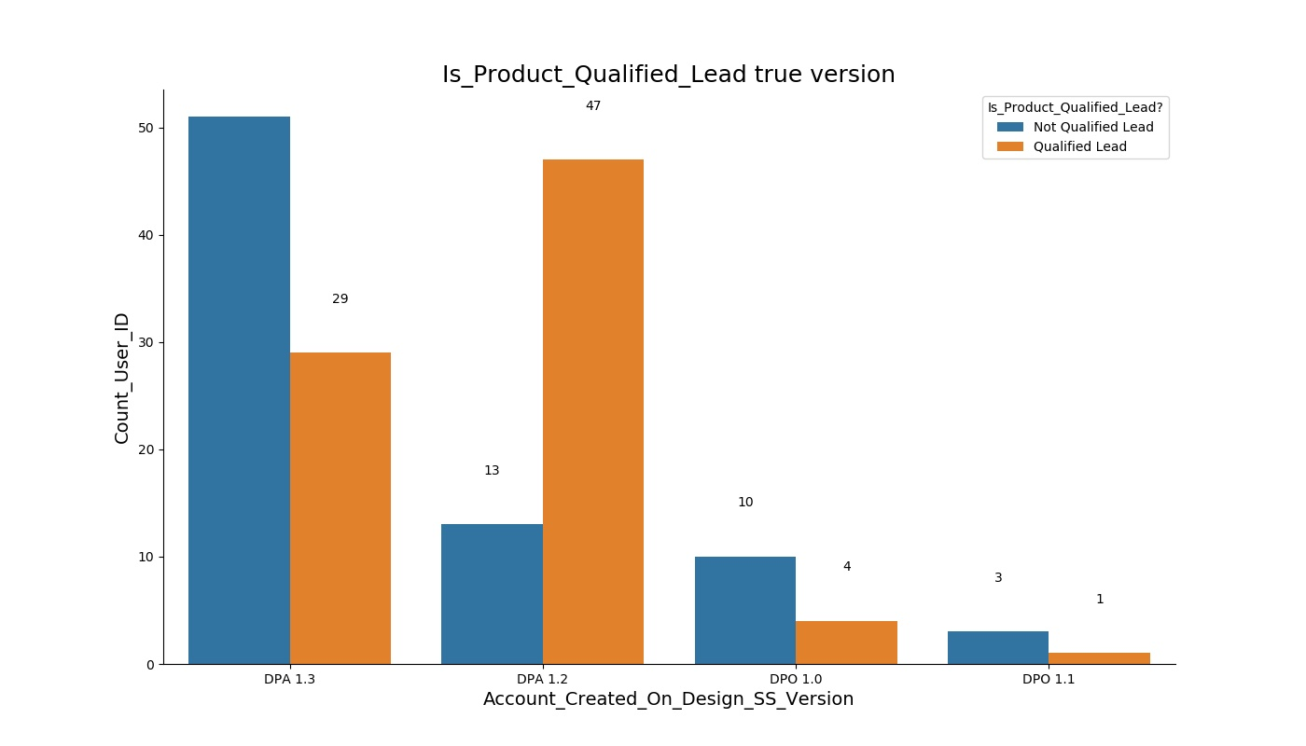
Qualified Lead by Incomplete BA Users
Design Version | Not Qualified Lead | Qualified Lead | Grand Total
DPA 1.2 | 13 | 47 | 60
DPA 1.3 | 51 | 29 | 80
DPO 1.0 | 10 | 4 | 14
DPO 1.1 | 3 | 1 | 4
Grand Total | 77 | 81 | 158

Slide 17
Insight Analysis Conclusion
Total 436 Users have taken BA assessment and out of which 278 have completed the assessment and rest of the Users have not.
There are 4 different Design Version which Users have used to take BA assessments which is used to categorized the data into 4 different version.
The analysis shows in detail time spent by Users on BA assessment and the Users who have completed the assessments have spent 14hours + more time than the Users who have not.
This analysis helped to determine the conversion rate of users who are more likely to lead to potential customers. The conversion rate of users who have completed the assessment are highest at 0.60 to 0.65 where as rest around 0.30 of user who are less potential customers.
The further of this analysis are DPA 1.3 and 1.2 are the most popular design version among the users than the rest.

Slide 18
Insight Analysis Conclusion
Since the users who have completed the BA assessment have spent more time, after further analysis we can conclude that most users who have used DPA 1.3 and 1.2 have spent more time on Self concept page and BA self page from between 4 to 6 hours of time and very less time spent on those pages by users who have used DPO 1.0 and DPO 1.1
Another interesting fact is that users from DPA 1.3 and DPO 1.0 have spent more time on complete pages than the rest.
Key Finding:
DPA 1.3 Design version is more popular and than any versions. All the pages are the important driver for this version and Users have spent maximum time on completed page which looks like real attract point for this version.
DPA 1.2 is next popular version among users and key driver pages are Self Concept page and Self page but users have spent very minimum time on completed page

Slide 19
Insight Analysis Conclusion
DPA 1.2 is next popular version among users and key driver pages are Self Concept page and Self page but users have spent very minimum time on completed page which is why might be the hold point for this version. This version has also the most loading page time which is also affects the interest of Users. The loading time is 1.4 hrs which is highest among all 4 versions.
Rest DPO 1.1 and 1.0 has less users to determined the key drivers but DPO1.0 has 2nd highest number of users on completed pages which shows potential in this version.

